Slide 1
ROLE OF CENTRAL BANKS

Slide 2
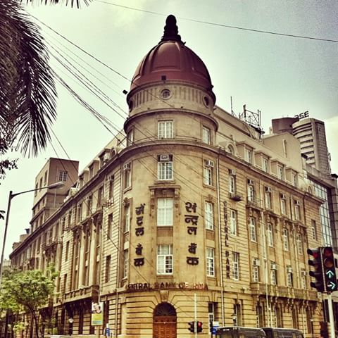

Slide 3
INTRODUCTION
Central bank- apex body of the banking and financial system.
Reserve Bank of India was established on 1st April, 1935.
Crucial to ensure growth of a nation.
Functions are increasing day by day with increase in economy of the country.

Slide 4
OBJECTIVES
Stablility of monetary and financial system.
Regulation of Financial Markets.
Regualtion of Inflation.
Effective payment system for safe transactions.
Regulation of International markets.

Slide 5
CONTROLLER OF CREDIT
BANK OF ISSUING AUTHORITY
BALANCED REGIONAL DEVELOPMENT
TRADITIONAL FUNCTION
CUSTODIAN OF FOREIGN EXCHANGE
BALANCE OF PAYMENT
CONTROL CLEARING HOUSE

Slide 6
INFLATION TARGETING
Inflation targeting refers to the policy of the central bank fixing a certain rate of inflation as the target. The central bank estimates the expected rate of inflation, mkes it public as the target rate.
If the actual rate of inflation is different from the target rate, then measures are taken to achieve the targeted rate.

Slide 7
The Reserve Bank if India has announced am inflation target of 4% with +/-2% as the tolerance level.

Slide 8
EXCHANGE RATE TARGETING.
It refers to a targeted exchange rate against another currency or group of currencies. This policy helps to manage exchange rate fluctuation and protect the economy from a volatile foreign exchange market.
The targeted exchange rate also depends on the nature of the economy, developed or developing.

Slide 9
Exchange rate targeting aims at stability in the economy

Slide 10
MONEY SUPPLY TARGETING
This targeting is also knows as money growth targeting.
Money supply targeting implies fixing a target or limit for money supply in the economy .

Slide 11
Like money supply target, money growth target indicates the target for the growth of money supply.

